Slide 1
Modelling health diagnoses
Ishan Sharma

Slide 2
Overview
Cancer is a complicated disease with variate causes
It is clustered severally into geographic regions
It is extremely complex to analyze cancer incidence, and to predict cancer

Slide 3
Data science vision
Data which goes in depth on the subject of cancer incidence may be found easily
As can data on potential indicators
So by collating this data together, a model may be found to predict cancer incidence in a person
As well as potential causes
Through this model, I can predict cancer incidence
And see factors which should be investigated to fix

Slide 4
Impact
If a model has been made correctly, and uses innovative data, it could show factors correlated with cancer
And with further research verifying these correlations, they could be tackled
Model could also be used to predict if individuals has high probabilities of cancer to be inspected

Slide 5
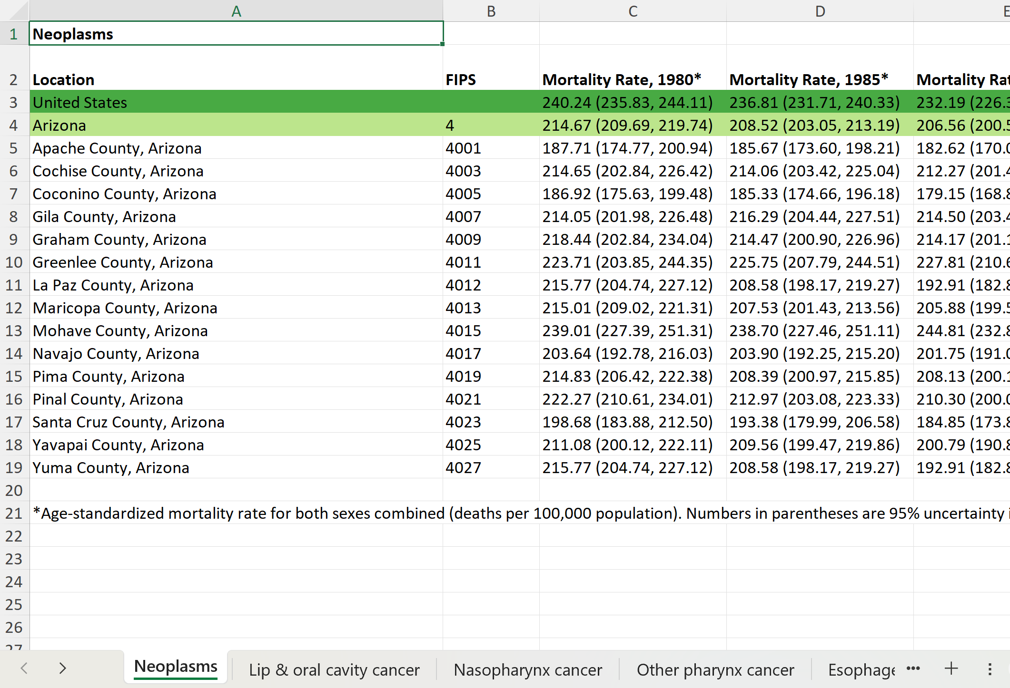
Data
Data obtained from the Institute for Health Metrics and Evaluation
Centerpiece is cancer mortality rate by county, divided into several spreadsheets by state and sheets within it by type of cancer
37 types of cancer
With mortality rate by year from 1980-2014 for each
Processed through Pandas function
Then combined through pd.concat
Clean except for FIPS and asterisk lines (removed), spreadsheets were made for human eyes largely
Additionally, more collated stats at the national level, but this is the main piece of data

Slide 6
Next steps
Build basic model collated against both the year intervals and by geography
See potential indices that might contribute to cancer over same intervals and model against it
Might require acquisition of more data to this goal

